Slide 1
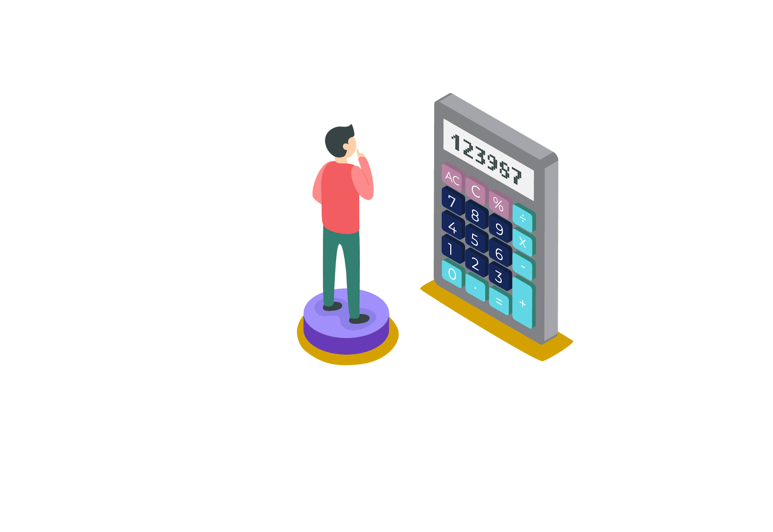

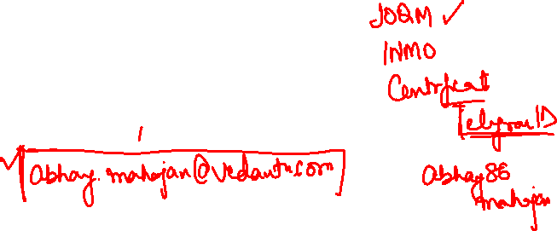
ABHAY MAHAJAN
B.Tech. IIT Roorkee
11+ years teaching experience
Mentored and taught around 20000+ students
Produced 400+ IIT selections
10+ INMO selections
1 EGMO Selection

Slide 2

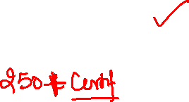

Slide 3


Slide 4

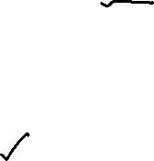

Slide 5



Slide 6



Slide 7
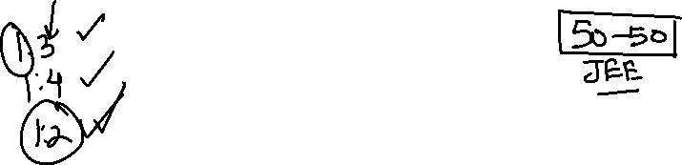
Fermat’s Theorem
Euler Function

Slide 8
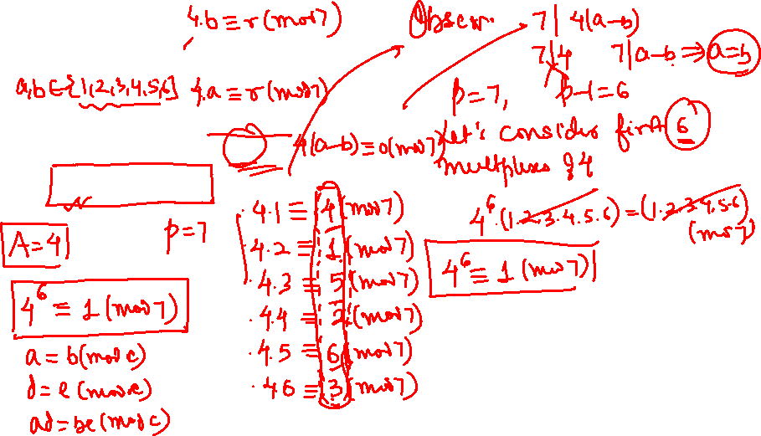
FERMAT’S THEOREM
Statement: Let p be prime number and A be a number not divisible by p.
Then A^{p - 1} ≡ 1 (mod p).

Slide 9
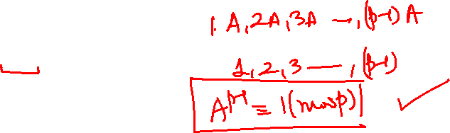
FERMAT’S THEOREM
Statement: Let p be prime number and A be a number not divisible by p. Then A^{p - 1} ≡ 1 (mod p).
Proof: Consider the p – 1 numbers: A, 2A, 3A, …., (p – 1)A.
We can show that no two of these numbers have the same remainder when divided by p. Indeed, if kA ≡ nA (mod p), then
k ≡ n (mod p). This is impossible if k and n are unequal and both are less than p.
Therefore, among the remainders of these p – 1 numbers when divided by p each of the numbers 1 through p - 1 is represented exactly once.
Multiplying them together, we have
A.2A.3A …. (p – 1)A ≡ 1 2 3 … (p – 1) (mod p);

Slide 10
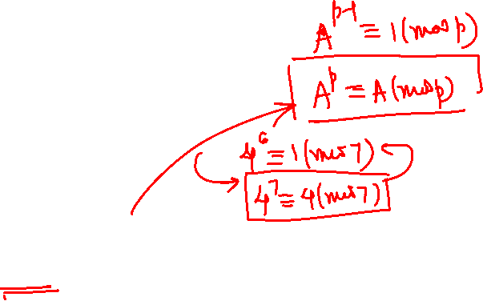
FERMAT’S THEOREM
Statement: Let p be prime number and A be a number not divisible by p. Then A^{p - 1} ≡ 1 (mod p).
Proof: That is, (p – 1)! A^{p – 1} ≡ (p – 1)! (mod p). Now p is prime, which implies that (p – 1)! and p are relatively prime.
We obtain A^{p - 1} ≡ 1 (mod p).
Corollary: Let p be a prime number. Then for any integer A we have A^{p} ≡ A (mod p). Fermat’s little theorem is not just an unexpected and “neat” fact. It also provides a very powerful tool for solving many problems in arithmetic. Let’s see some of them !!!!

Slide 11
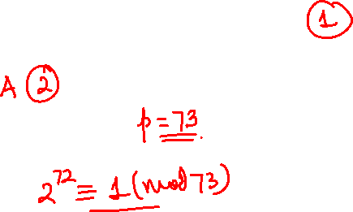
Q. Find the remainder when 2⁷² is divided by 73.

Slide 12
Q. Find the remainder when 2⁷² is divided by 73.
Solution
Since 73 is prime,
2⁷³ ⁻ ¹ ≡ 1 (mod 73)
⇒ 2⁷² ≡ 1 (mod 73)
∴ Remainder is 1.

Slide 13
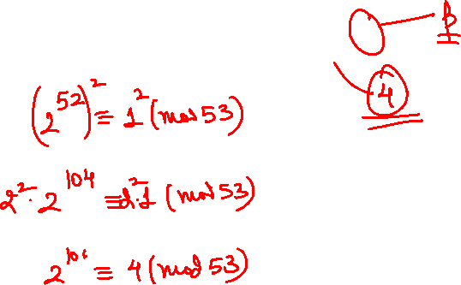
Q. Find the remainder when 2¹⁰⁶ is divided by 53.

Slide 14
Q. Find the remainder when 2¹⁰⁶ is divided by 53.
Solution
2⁵² ≡ 1 (mod 53)
Square both sides
2¹⁰⁴ ≡ 1 (mod 53).....(1)
2² ≡ 4 (mod 53).....(2)
Multiplying (1) and (2)
⇒ 2¹⁰⁶ ≡ 4 (mod 53)
⇒Remainder = 4

Slide 15
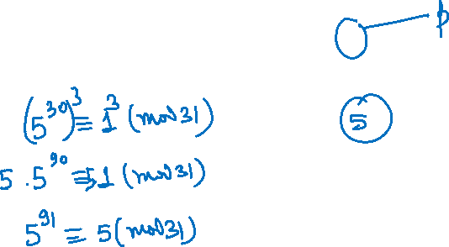
Q. Find the remainder when 5⁹¹ is divided by 31.

Slide 16
Q. Find the remainder when 5⁹¹ is divided by 31.
Solution
5³⁰ ≡ 1 (mod 31)
Take cube on both sides
5⁹⁰ ≡ 1 (mod 31)
Multiply with 5
5⁹¹ ≡ 5 (mod 31)
Remainder = 5

Slide 17
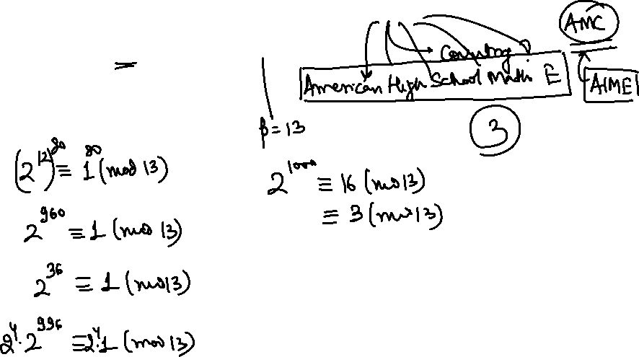
Q. The number 2¹⁰⁰⁰ is divided by 13. What is the remainder?
1972 AHSME

Slide 18
Q. The number 2¹⁰⁰⁰ is divided by 13. What is the remainder?
Solution
By Fermat’s Little Theorem
2¹² ≡ 1 mod 13.
Thus, 2¹⁰⁰⁰ ≡ 2⁴⁰⁰ ≡ 2⁴⁰ ≡ 2⁴ ≡ 16 ≡ 3 mod 13.

Slide 19
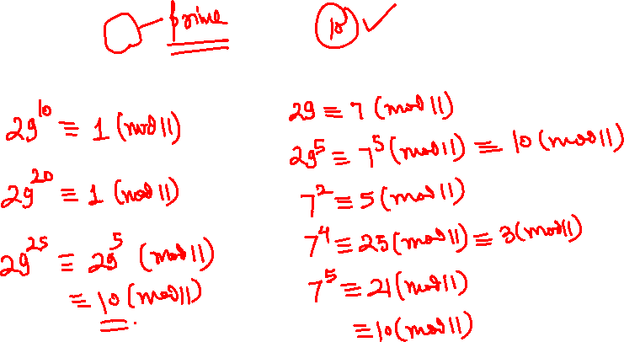
Q. Find 29²⁵ mod 11.

Slide 20
Q. Find 29²⁵ mod 11.
Solution
By Fermat’s Little Theorem,
29¹⁰ ≡ 7¹⁰ ≡ 1 mod 11.
Thus, 29²⁵ ≡ 7⁵ ≡ 7 (–4)⁴
≡ 7.256 ≡ 7.3 ≡ 21 ≡ 10 mod 11.

Slide 21
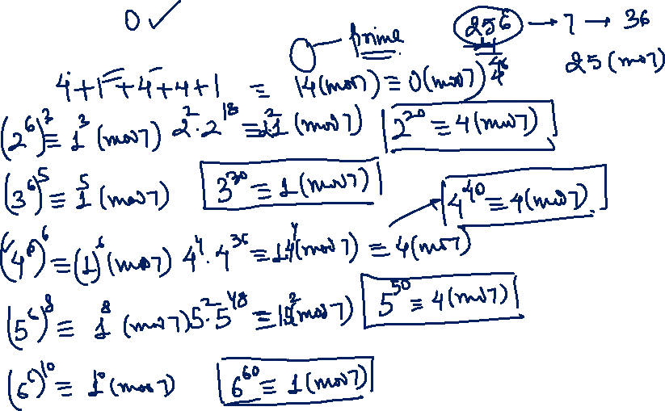
Q. Find 2²⁰ + 3³⁰ + 4⁴⁰ + 5⁵⁰ + 6⁶⁰ mod 7.

Slide 22
Q. Find 2²⁰ + 3³⁰ + 4⁴⁰ + 5⁵⁰ + 6⁶⁰ mod 7.
Solution
By Fermat’s Little Theorem,
2⁶ ≡ 3⁶ ≡ 4⁶ ≡ 5⁶ ≡ 6⁶ ≡ 1 mod 7
Thus 2²⁰+ 3³⁰+ 4⁴⁰+ 5⁵⁰ + 6⁶⁰
≡ 2² + 3⁰ + 4⁴ + 5² + 6⁰
≡ 4 + 1 + 2⁸ + 25 + 1
≡ 4 + 1 + 4 +4 + 1 ≡ 14 ≡ 0 mod 7.

Slide 23
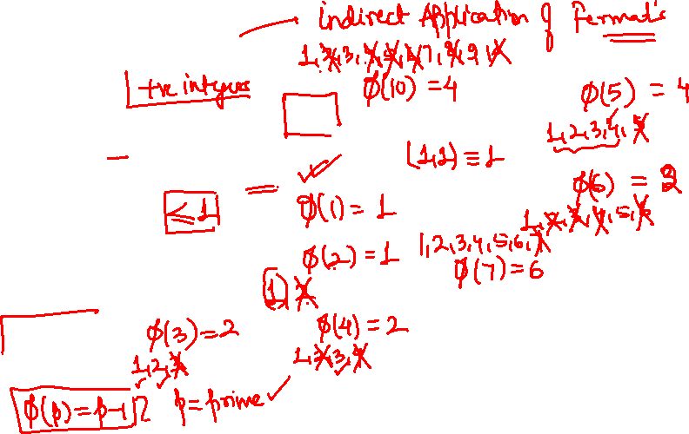
EULER’S FUNCTION
The number of integers ≤ n and coprime to n is called Euler’s function for n and is denoted by Φ(n).
Examples:
Φ(1) = 1
Φ(2) = 1
Φ(8) = 4

Slide 24
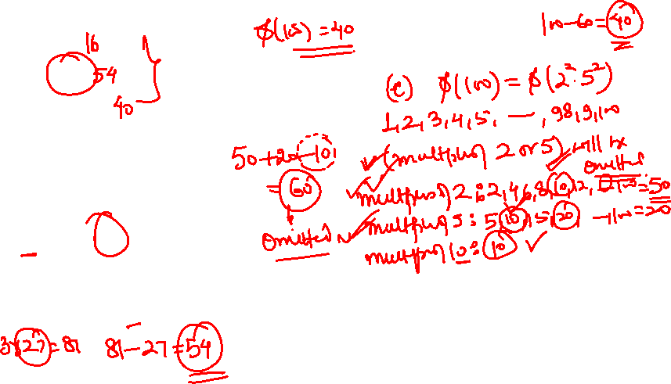
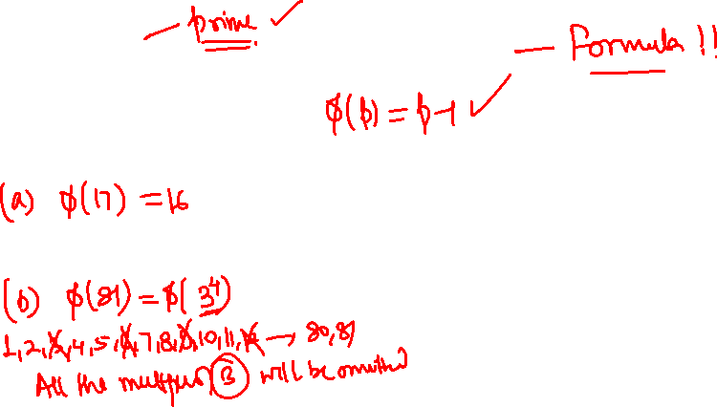
Q. (a) Find φ (17)
(b) Find φ (81)
(c) Find φ (100)

Slide 25
Solution
Ф (17) = 16 because none of the integers in {1,..., 17) except 17 itself have any common divisor with 17.
Ф (81) = 54: from the integers {1,...,81} we exclude the ones divisible by 3, of which there are 27.
Ф(100) = 40. There are two ways to do this
There are 50 numbers in {1,....100} divisible by 2, which we discard. There are also 20 numbers divisible by 5, which we discard. But 10 numbers were divisible by 10, so we counted them since twice so
Ф (100) = 100 –50 – 20 + 10 = 40
Of the numbers in {1,...100}, ½ are not divisible by 2, and ⅘ are not divisible by 5. So the number that aren’t divisible by both is ½. ⅘. 100 = 40.

Slide 26
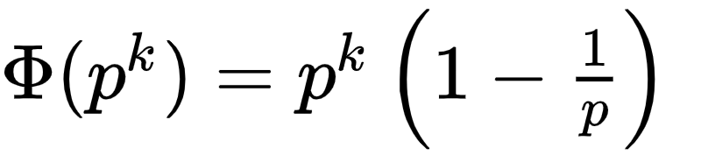
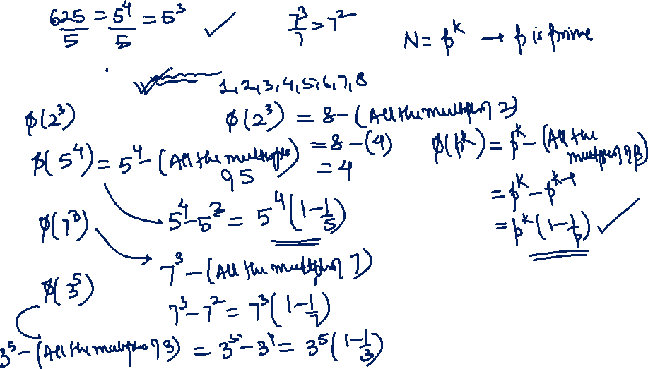
Q. Prove that , where p is prime

Slide 27
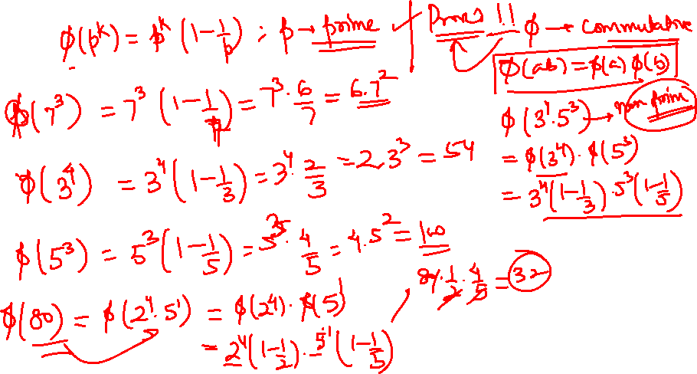

Slide 28
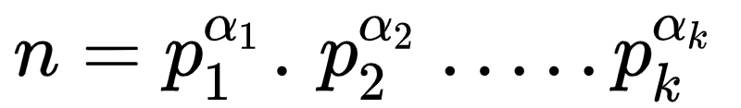
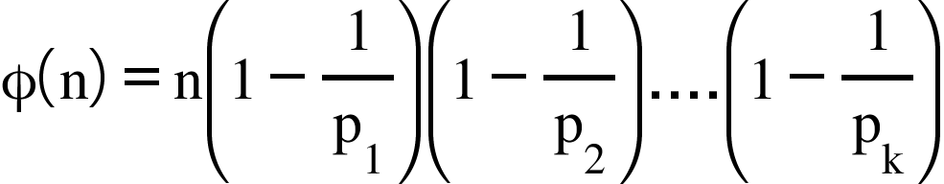
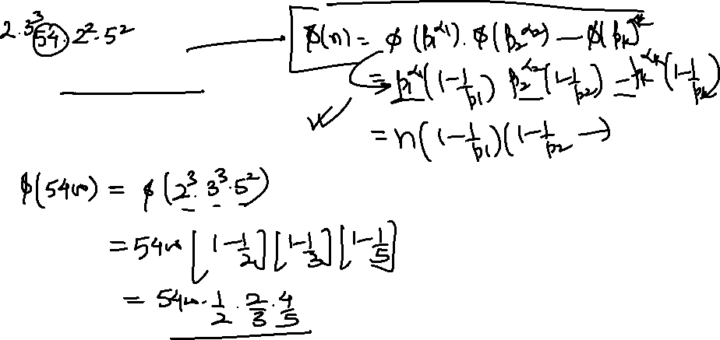
EULER’S FUNCTION
If then

Slide 29
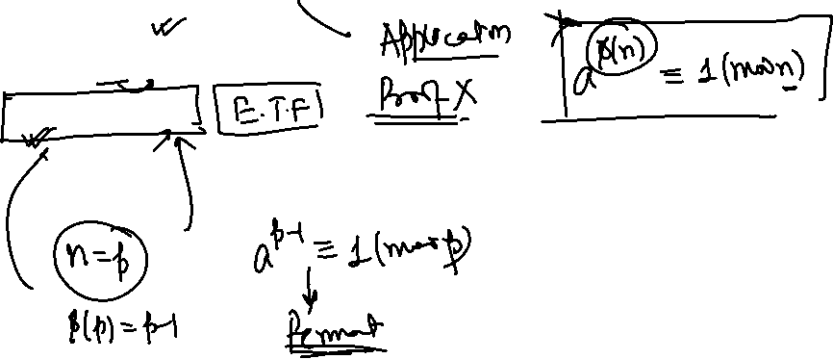
Euler’s Theorem
If gcd (n, a) =1, then
a^{ф(n)} ≡ 1 (mod n)
If n = p, then we obtain Fermat’s little theorem.

Slide 30
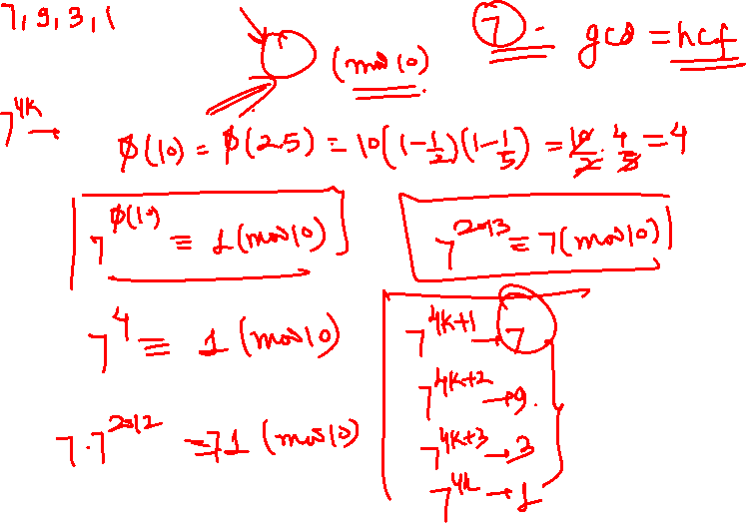
Q. Find the last digit of 7²⁰¹³.

Slide 31
Q. Find the last digit of 7²⁰¹³.
Solution
Since ф(10) = 4, to find 7²⁰¹³ mod 10 we find
2013 mod 4 = 1.
So 7²⁰¹³ ≡ 7¹ = 7 (mod 10).

Slide 32
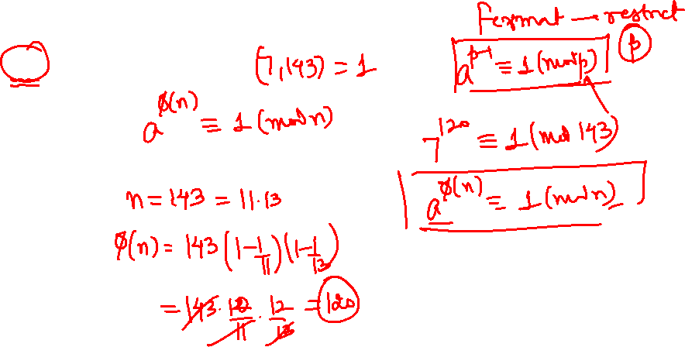
Q. Find the remainder when 7¹²⁰ is divided by 143.
A
0
B
1
C
5
D
6

Slide 33
Q. Find the remainder when 7¹²⁰ is divided by 143.
A
0
B
1
C
5
D
6

Slide 34
Q. Find the remainder when 7¹²⁰ is divided by 143.
Solution
143 = 11 x 13,
7¹²⁰ ≡ 1 (mod 11)
7¹²⁰ ≡ 1 (mod 13)
∴ Remainder is 1.

Slide 35
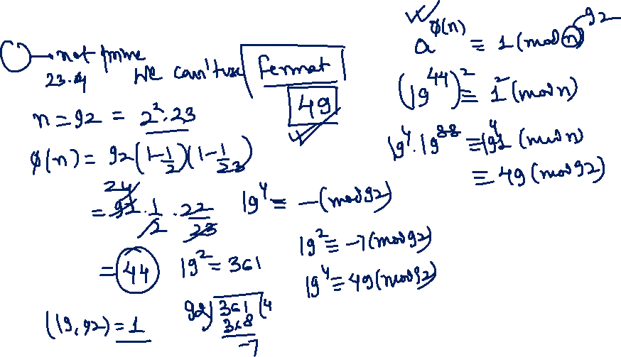
Q. Determine the remainder of 19⁹² upon division by 92.
INMO 1992

Slide 36

Q. Determine the remainder of 19⁹² upon division by 92.
Solution
We are asked to find
19⁹²(mod 92) since 19 and 92 are relatively prime, we can use euler’s theorem extension of FLT
note that
(19⁴²)².19⁴ mod 92 ≡ 19⁴ mod 92
and from here, is simple , but
≡ 19⁴ mod 92 ≡ (361)² ≡ 85² ≡ 7225 ≡

Slide 37
SAWAAL

Slide 38
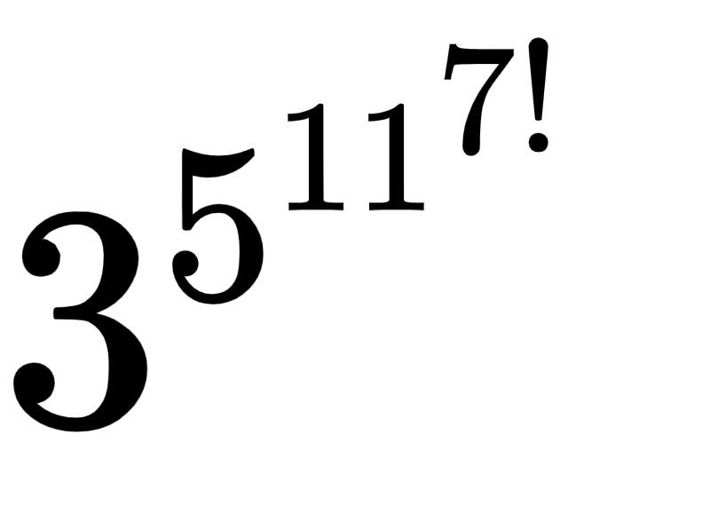
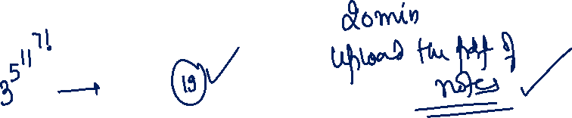
Q.Find the remainder when is divided by 19.
Note: Solution at the End

Slide 41
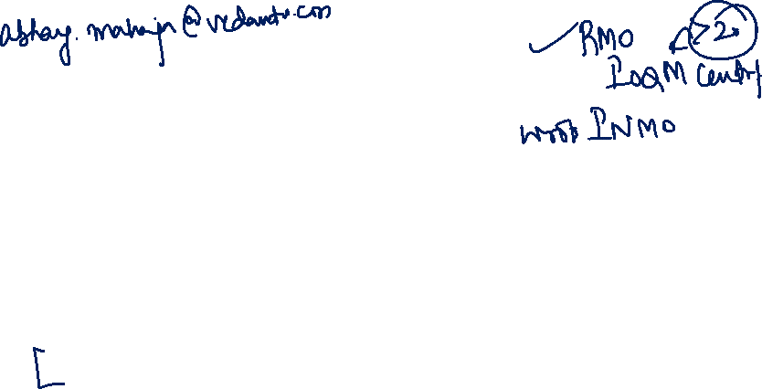

Slide 44




Let’s Bring
GOLD
For
INDIA

Slide 45
Q.Find the remainder when is divided by 19.

Slide 46
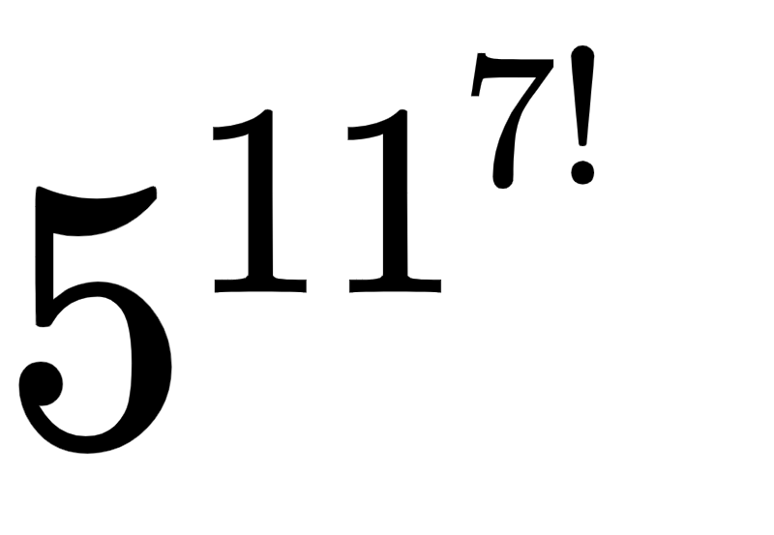
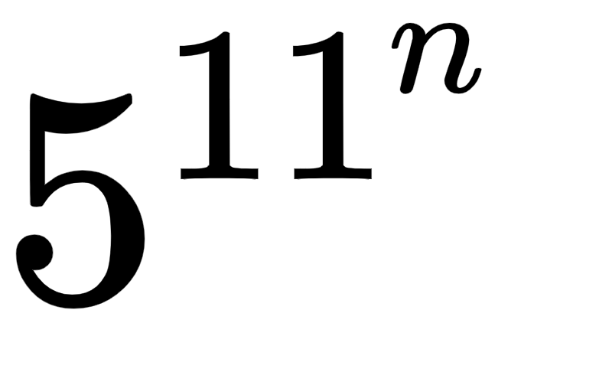
Solution
By Fermat’s little theorem we have 3¹⁸ ≡ 1 ( mod 19).
This hints that we will want to find in modulo 18.
Now note that ф(18) = 6.
So by Euler’s theorem we have, 5⁶ ≡ 1 (mod 18)
This hints that we will want to evaluate 11^{7!}
In modulo 6, this is easy because
11^{7!} ≡ (–1)^{7!} ≡ 1 (mod 6)
So there exist a such that 11^{7!} = 6a +1 , hence
≡ 5^{6a}.5 ≡ 5 ( mod 18).
This means that there exists b such that = 18b + 5,
so
≡ 31^{8b}. 3⁵ ≡ 3⁵ ≡ 15 ( mod 19).

